Slide 1


SHOE INVENTORY MANAGEMENT SYSTEM
Implementation
Problem Statement
Conclusion
Description
Introduction
Discussion
Yashi Chaturvedi – E&TC A – 05
Amal Mehta – E&TC A – 38
Bhavesh Purohit – E&TC A - 60

Slide 2
SHOE INVENTORY MANAGEMENT SYSTEM
An inventory management system is the combination of technology (hardware and software) and processes and procedures that oversee the monitoring and maintenance of stocked products.
This software does the following:
Records the information about the stocks of an organization
Perform basic operations, purchase and sales of the products.
Developed to increase the efficiency of an organization
Problem Statement
Introduction
Implementation
Conclusion
Discussion
Description

Slide 3
SHOE INVENTORY MANAGEMENT SYSTEM
Due to a huge amount of numbers of shoes stock & sales in a particular shop/organization, it is not feasible to keep a hand record.
Without an inventory management system, the goods and products that flow through an organization will inevitably be in disarray.
Our project enables a company to maintain a centralized record of every asset and item in the control of the organization and allows many users to work on the same set of data, with immediate updating.
Introduction
Description
Problem Statement
Implementation
Conclusion
Discussion

Slide 4
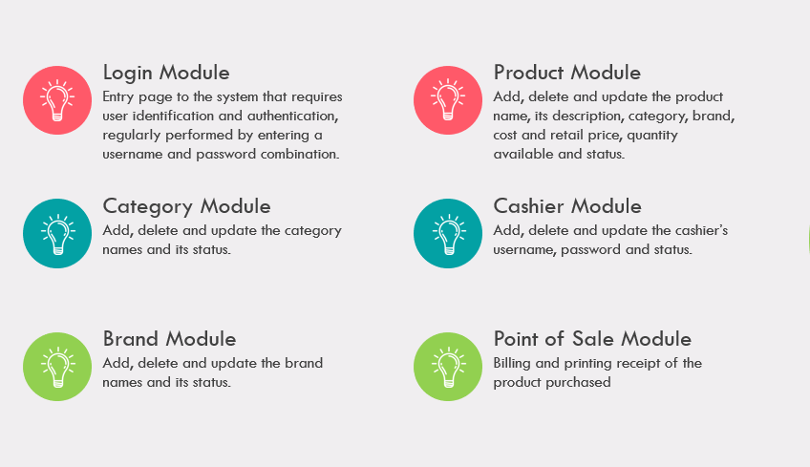
SHOE INVENTORY MANAGEMENT SYSTEM
Introduction
Problem Statement
Implementation
Conclusion
Discussion
Description

Slide 5
SHOE INVENTORY MANAGEMENT SYSTEM
Software used:
Operating System | Windows, MacOS, Linux
IDE | NetBeans IDE 8.2
Frontend | Java Swing
Backend | MySQL
Server | Xampp
Introduction
Problem Statement
Conclusion
Implementation
Discussion
Description

Slide 6

SHOE INVENTORY MANAGEMENT SYSTEM
Login Module
Product Module
Entry page to the system that requires user identification and authentication, regularly performed by entering a username and password combination.
Add, delete and update the product name, its description, category, brand, cost and retail price, quantity available and status.
Category Module
Cashier Module
Discussion
Problem Statement
Conclusion
Add, delete and update the category names and its status.
Add, delete and update the cashier’s username, password and status.
teams
about
Description
Brand Module
Point of Sale Module
Add, delete and update the brand names and its status.
Billing and printing receipt of the product purchased

Slide 7
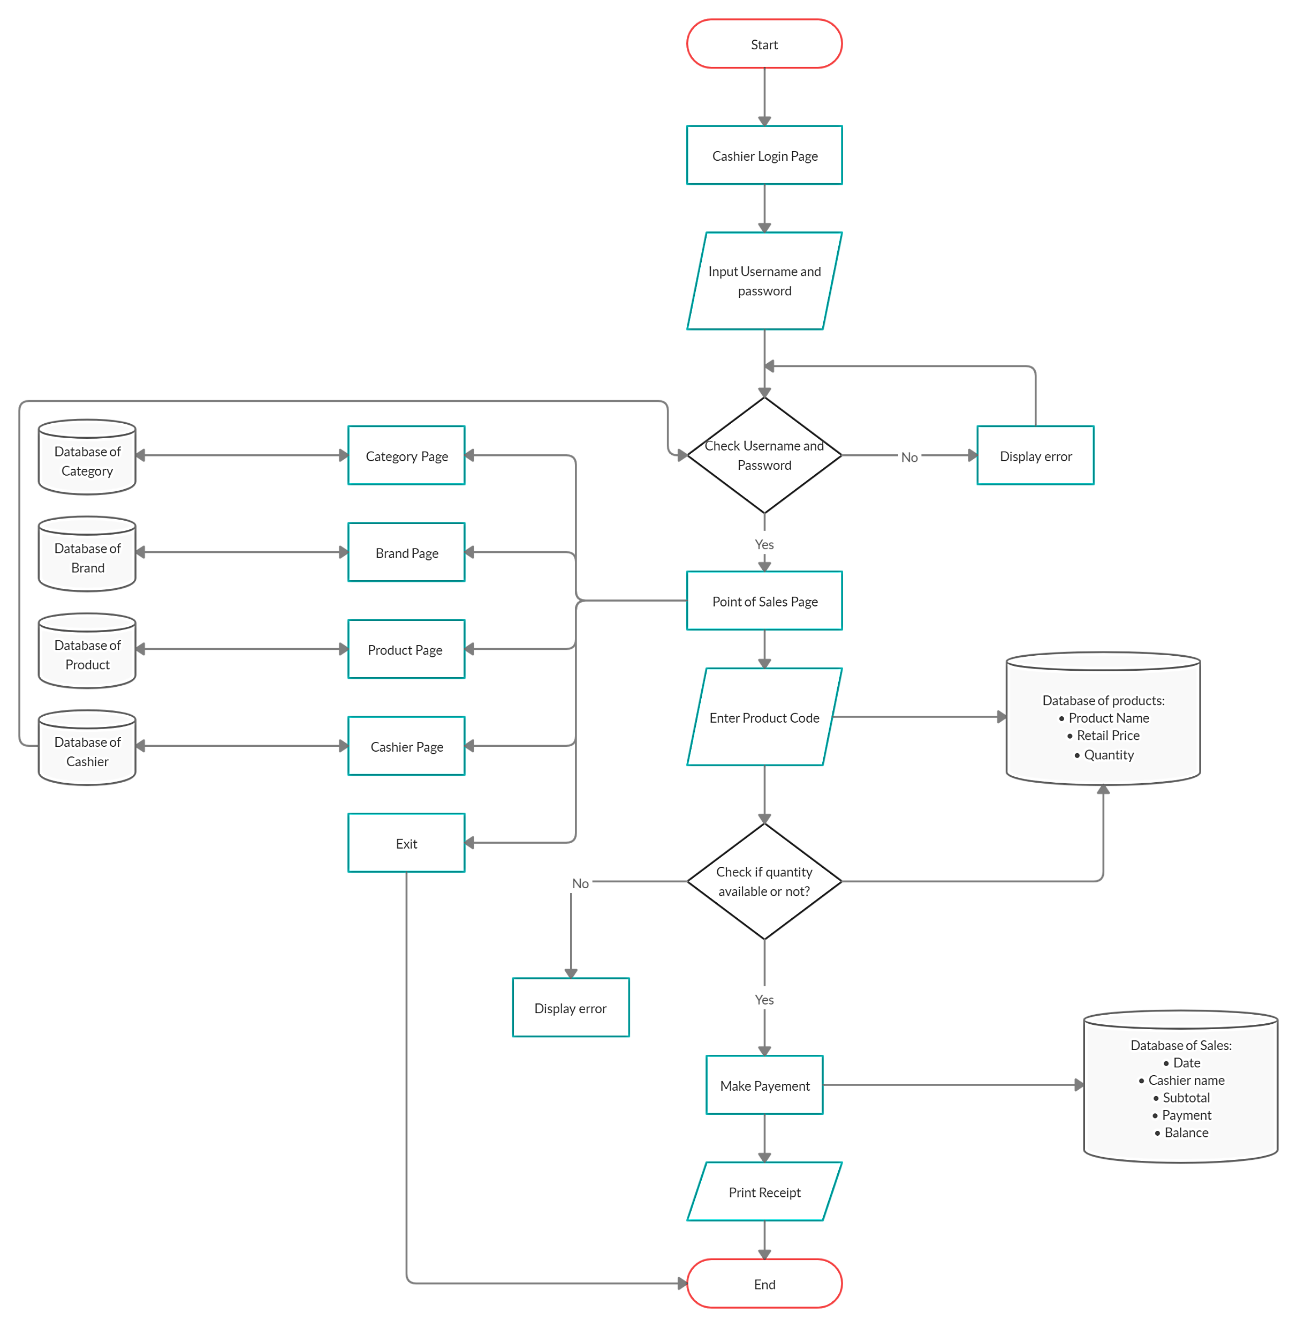
SHOE INVENTORY MANAGEMENT SYSTEM
Problem Statement
Discussion
Introduction
Conclusion
Implementation
Description

Slide 8
SHOE INVENTORY MANAGEMENT SYSTEM
Managing stock is a hard job. But managing stock correctly is a considerably harder job. However, your stock is an important part of your business you have to work at improving the effectiveness, so as to enable your business, to flourish.
Our project fulfills the customer needs by:
Reducing inaccuracies
Increasing Efficiency & Productivity in Operations
Minimizing the Costs and Maximizing Sales & Profits
Automation of Manual Tasks
Keeping Customers Happy
This system will give the staff relief from exhausted life which they are dealing with their customers. Besides this system will make them more reliable to its customers as all the customers records will be kept safely than any previous times. Moreover, they can manage their stock more handily.
Problem Statement
Conclusion
Introduction
Implementation
Discussion
Description

Slide 9
SHOE INVENTORY MANAGEMENT SYSTEM
Managing stock is a hard job. But managing stock correctly is a considerably harder job. However, your stock is an important part of your business you have to work at improving the effectiveness, so as to enable your business, to flourish.
Our project fulfills the customer needs by:
Reducing inaccuracies
Increasing Efficiency & Productivity in Operations
Minimizing the Costs and Maximizing Sales & Profits
Automation of Manual Tasks
Keeping Customers Happy
This system will give the staff relieve from exhausted life which they are dealing with their customers. Besides this system will make them more reliable to its customers as all the customers records will be kept safely than any previous times. Moreover, they can manage their stock more handily.
THANK YOU..!!
Problem Statement
Conclusion
Introduction
Implementation
Discussion
Description

